Slide 1
Getting Started with AngularJS as a .NET Developer
Jake Adams
@jacobladams
Link Bundle http://bit.ly/jakeangular

Slide 2




































Platinum Sponsors
Gold Sponsors
Silver Sponsors

Slide 3
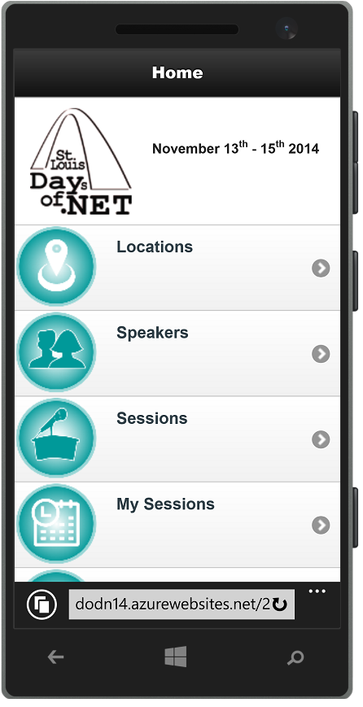
Conference Mobile App
dodn14.azurewebsites.net
Quick access to conference info
Build your custom agenda
Anonymously rate the sessions you attended
Share with the Twitter-verse

Slide 4




Fun Stuff Downstairs

Slide 5
About Me
Jake Adams
Software Architect
Thompson Coburn LLP
Email: jacobladams@gmail.com
Twitter: @jacobladams
geekswithblogs.com/jacobladams
github.com/jacobladams
Bit.ly bundle of links for this presentation - http://bit.ly/jakeangular

Slide 6

What is AngularJS?
JavaScript MVW (Model–View-Whatever) framework
HTML enhanced for web apps
Framework for building web applications in JavaScript and HTML

Slide 7


Slide 8
Why
Angular is a:
Client Side
JavaScript
Framework
For Building Web Applications

Slide 9
Things to consider
Full framework
Lots of functionality, but lots to learn.

Slide 10
GIVE MEH TEH CODEZ!

Slide 11
Jake Adams
Software Architect
Thompson Coburn LLP
Email: jacobladams@gmail.com
Twitter: @jacobladams
geekswithblogs.com/jacobladams
github.com/jacobladams
Bit.ly bundle of links for this presentation - http://bit.ly/jakeangular

